Slide 1
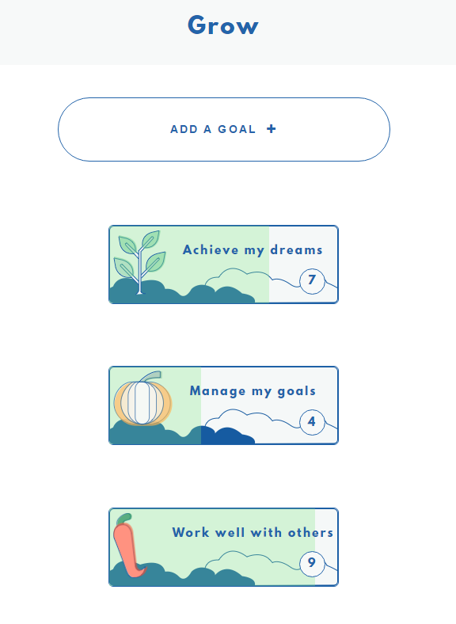


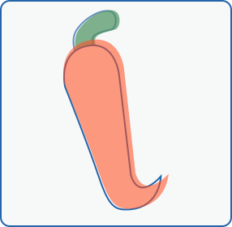


Slide 2

Grow
An app for supporting the use of Goal Based Outcomes in clinical work
For young people between 11-19 years

Slide 3
Grow
Goal Based Outcomes are a way to evaluate progress in clinical work
They are a measure of what the young person or family wants to achieve
Goal setting facilitates shared decision making and collaborative practice

Slide 4

Need
There is a good evidence base for goals improving outcomes and shared decision making in clinical work
They are a key component of CYP IAPT
Currently goals are mostly paper based, or on white boards
Typically static and inaccessible between sessions
Owned by the provider service rather than the young person

Slide 5
Evidence Base
Better ways for measuring what is important to children and young people in clinical work are needed (Jacob, et al 2015)
Goals capture areas not captured by other normed outcome measures, esp. higher order, underlying factors, e.g. confidence, resilience, coping, and parenting factors. (Jacobs, et al 2015b)
Goals promote collaborative practice (Jacob, et al, 2016)
Correlation between use of goals in clinical work and satisfaction with services (Jacob, et al, 2016)

Slide 6
User Experience Feedback
people like the clean design
growth / nature are positive themes
navigation needs some work, the feedback here has been really useful though!
most people thought it would be useful, and a good alternative to paper
we need to work on browser compatibility, and do much more testing

Slide 7
User Experience Feedback
https://youtu.be/LvkXHzKJjQo?t=18s
https://youtu.be/svoOODl8qng?t=28s

Slide 8
Product Roadmap
1st iteration:
Database (Storing goals, etc)
User can log in and out
Browser compatibility
Mail server, email notifications when a user signs up to the platform
Record reasons for scoring goals up or down
Choice of ‘thing’ to grow, e.g. pumpkin, cactus, to represent goal
Line chart to represent progress over time
Login for the clinician? generating a report for a clinician?
Accessibility

Slide 9
Technical Viability
The challenge in delivering this app is not technical complexity,
It is the volume of work to achieve a level of functionality to make the app useful

Slide 10

Product Ownership
Able to make time to steer the product
Wide network to draw clinical advice and feedback from young people

Slide 11
Implementation
Young people typically have smartphones though this is a constraint for access
An increasing number of clinicians in provider services have tablets, and most if not all have access to laptop/desktop computer
Of the clinicians and young people interviewed for UX feedback, the majority were enthusiastic about bringing the app into their work/life.

